Slide 1
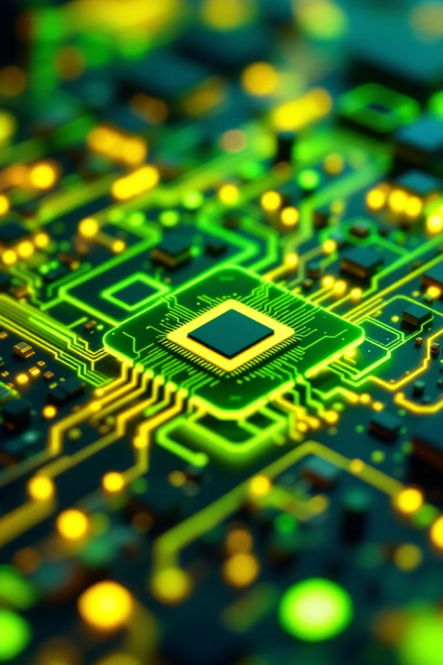
Computer Organization: Understanding the Foundation of Computer Architecture
資工一
卓孝偉 111210551

Slide 2
Introduction to Computer Organization
Understanding the Building Blocks
Laying the Foundation for Architecture
Computer organization delves into the internal structure and functioning of computers, exploring how different components work together to execute instructions and process data. This field is crucial for understanding how computers operate at a fundamental level.
Understanding computer organization provides a strong foundation for learning computer architecture, which focuses on designing and implementing computer systems. By grasping the underlying principles, we can better analyze and design efficient and effective computing solutions.

Slide 3
Central Processing Unit (CPU): The Brain of the Computer
The Control Center
Key Components
The CPU, often referred to as the brain of the computer, is responsible for executing instructions and performing calculations. It fetches instructions from memory, decodes them, and carries out the specified operations.
The CPU consists of multiple components, including the Arithmetic Logic Unit (ALU) for calculations, the control unit for instruction decoding, and registers for temporary data storage.

Slide 4




Memory Hierarchy: From Registers to Secondary Storage
Registers
1
Fastest access, limited capacity, used for temporary data storage during computation.
Caches
2
Faster than main memory, smaller capacity, used to store frequently accessed data.
Main Memory
3
Primary storage for program instructions and data, accessed by the CPU.
Secondary Storage
4
Persistent storage for data, slower access, used for long-term data retention.

Slide 5
Instruction Set Architecture (ISA): The Language of the CPU
Defining the Operations
Bridging the Gap
The ISA defines the set of instructions that a CPU can understand and execute. It dictates the format of instructions, their operands, and the operations they perform.
The ISA acts as a bridge between the high-level programming languages used by developers and the low-level instructions that the CPU can execute.

Slide 6
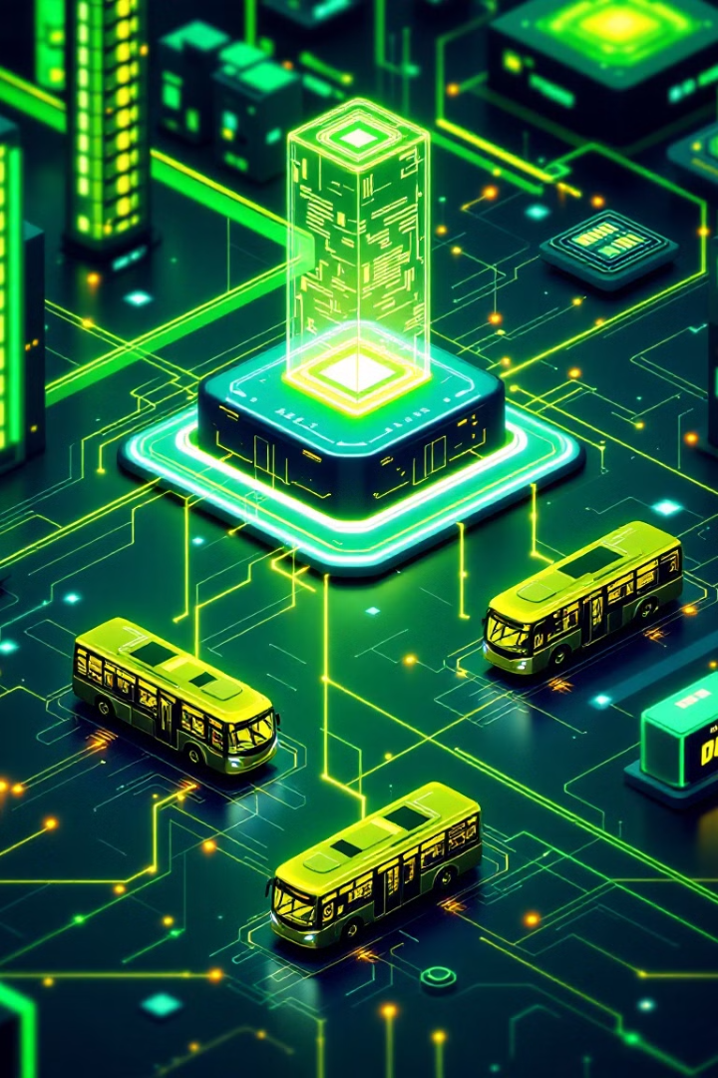



Bus Systems: The Communication Channels
Data Bus
Carries data between different components, facilitating data transfers.
Address Bus
Transmits memory addresses, enabling the CPU to access specific memory locations.
Control Bus
Controls the flow of data and instructions, synchronizing operations between components.

Slide 7
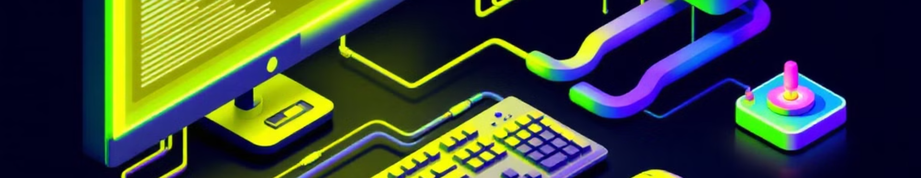




Input/Output (I/O) Systems: Interfacing with the Outside World
Keyboard
Mouse
Monitor
Printer
Allows users to input text and commands.
Provides a graphical interface for user interaction.
Displays visual output from the computer.
Produces hard copies of documents and images.

Slide 8

Pipelining: Improving Performance through Parallelism
1
Instruction Fetch
Fetches instructions from memory.
2
Instruction Decode
Decodes instructions and identifies operands.
3
Instruction Execute
Executes the decoded instruction.
4
Write Back
Stores results back into memory or registers.

Slide 9

Data Hazards: Challenges in Pipelined Execution
1
RAW (Read After Write)
2
WAR (Write After Read)
An instruction needs data written by a previous instruction.
An instruction writes to a register that is read by a previous instruction.
3
WAW (Write After Write)
An instruction writes to a register that is written to by a previous instruction.

Slide 10

System Performance Optimization: Balancing Components
CPU Optimization
Memory Optimization
Increase clock speed, use pipelining, optimize instruction set architecture.
Improve cache performance, increase memory bandwidth, optimize memory access patterns.
I/O Optimization
Use faster I/O devices, implement efficient data transfer protocols, reduce I/O overhead.

Slide 11
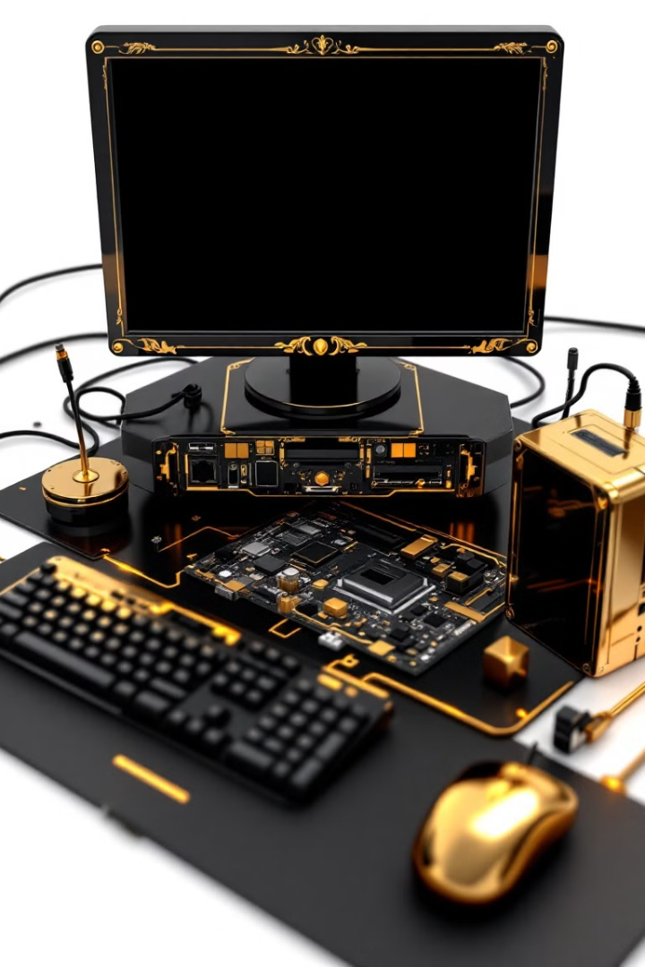
I/O Systems: Devices for Data Transfer
Input Devices
Output Devices
Input devices, such as keyboards and mice, allow users to interact with the computer and provide data.
Output devices, like monitors and printers, display or generate results for user consumption.
Storage Devices
Storage devices, including hard drives and SSDs, store data persistently for later retrieval.

Slide 12
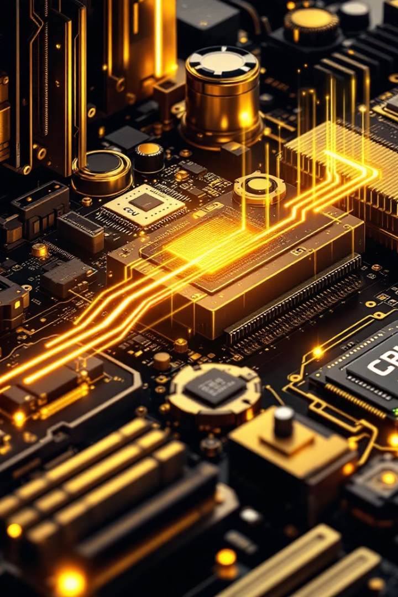


Interrupts: Handling Real-Time Operations
Interrupt Signal
Interrupt Handler
An interrupt is a signal generated by a device to notify the CPU of an event that requires immediate attention.
The CPU suspends its current operation and executes an interrupt handler routine to address the event.

Slide 13
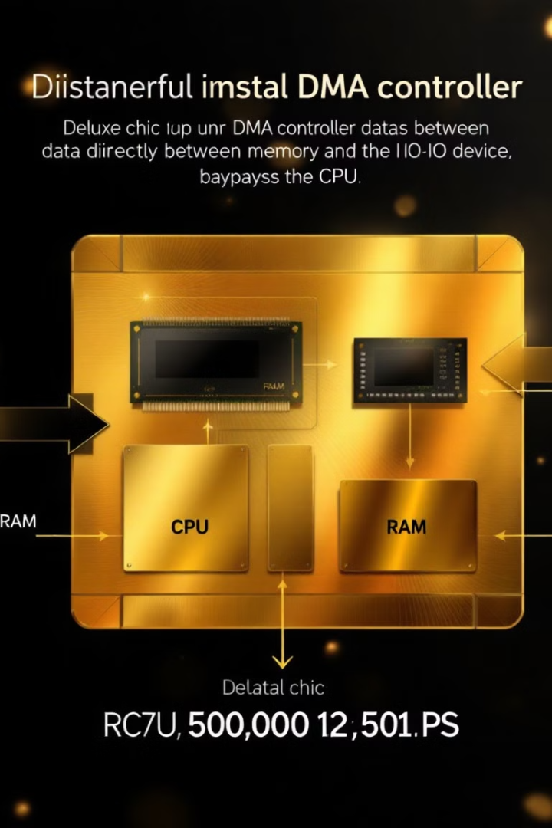


Direct Memory Access (DMA): Optimizing Data Transfer
Data Transfer
DMA allows devices to transfer data directly to or from memory, bypassing the CPU and reducing processing overhead.
Increased Efficiency
This mechanism optimizes data transfer speeds, freeing up the CPU to perform other tasks while the DMA controller manages the transfer.

Slide 14
Pipelining: Improving Processor Throughput
Instruction Fetch
1
The CPU fetches instructions from memory and prepares them for execution.
2
Decode
The instructions are decoded into a form that the CPU can understand and execute.
Execute
3
The decoded instructions are executed by the CPU's functional units.
4
Memory Access
If necessary, the CPU accesses memory to read or write data required for the instructions.
Write Back
5
The results of the execution are written back to memory or registers.

Slide 15



Instruction-Level Parallelism (ILP)
Pipeline
1
Pipelining allows multiple instructions to be in different stages of execution concurrently.
Superscalar
2
Superscalar processors have multiple execution units, capable of executing multiple instructions simultaneously.
Out-of-Order Execution
3
Advanced techniques allow instructions to be executed in an order that is different from their original order.

Slide 16
Cache Hierarchies and Memory Subsystems
L1 Cache
1
The L1 cache is the fastest and smallest level of cache, located directly on the CPU die.
L2 Cache
2
The L2 cache is larger and slower than the L1 cache, but still significantly faster than main memory.
L3 Cache
3
The L3 cache is the largest and slowest level of cache, but it serves as a larger buffer for frequently accessed data.

